Slide 1
Angular Final Project Mohamed Labbai

Slide 2
Features implemented
Following features have been implemented in this app development. JSON-Server-Auth nginx pipes Form handling Lazy loading of modules Routing, Child routing and params HTTPClient and Observables Angular Material Controls Service calls with secure end points (Token based auth)

Slide 3
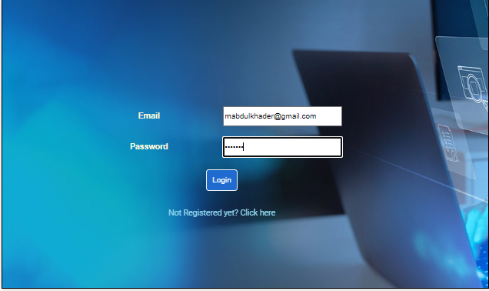
Login

Slide 4
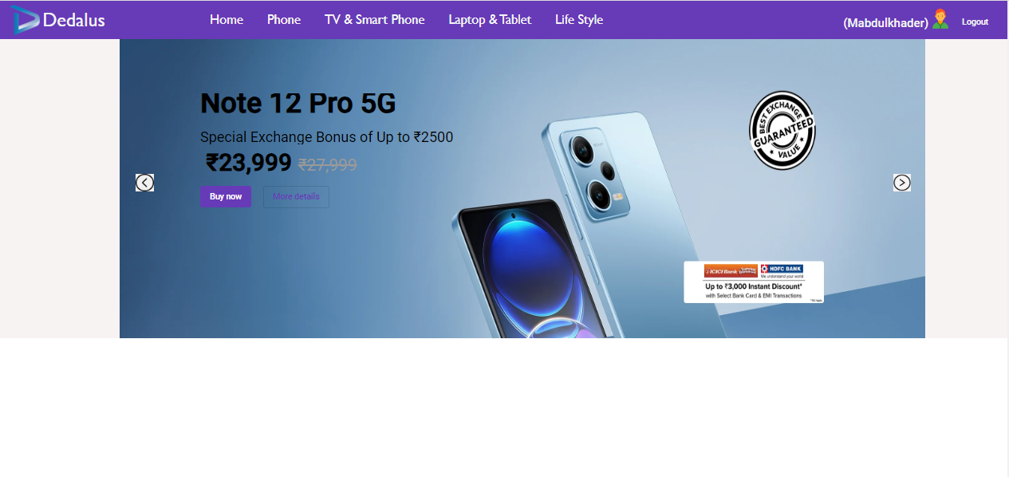
User - Home Page

Slide 5
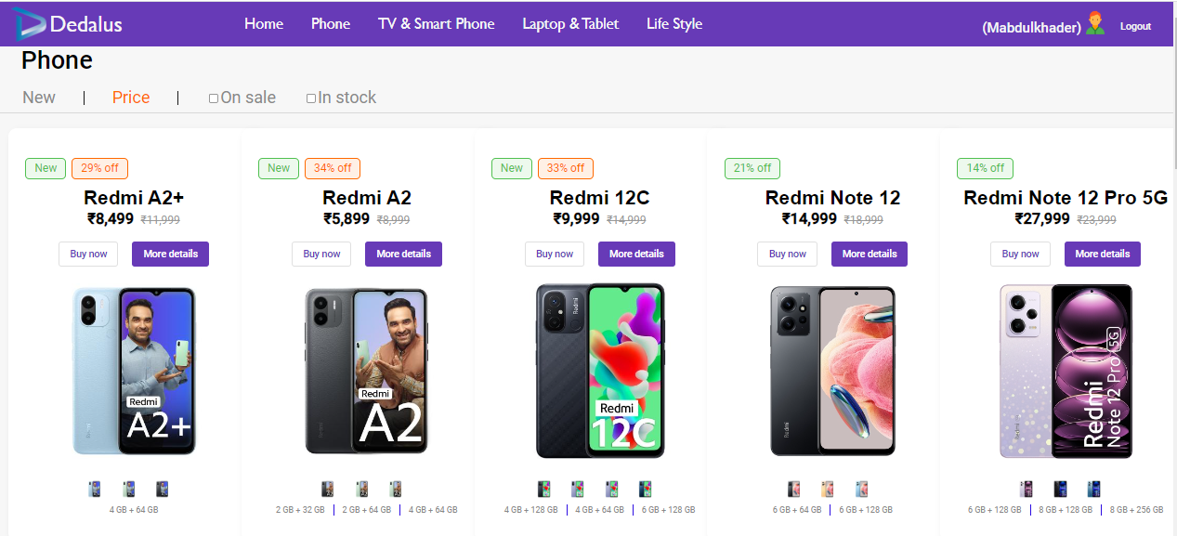
User - Main Page

Slide 6
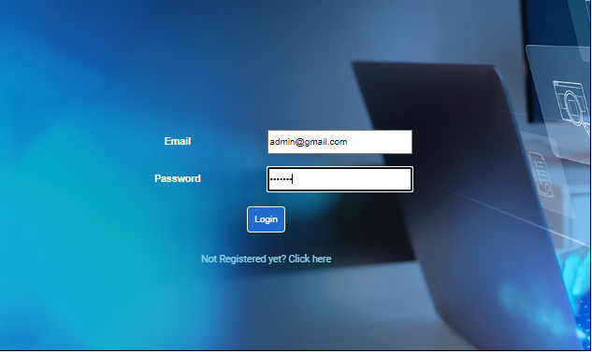
Admin Login

Slide 7
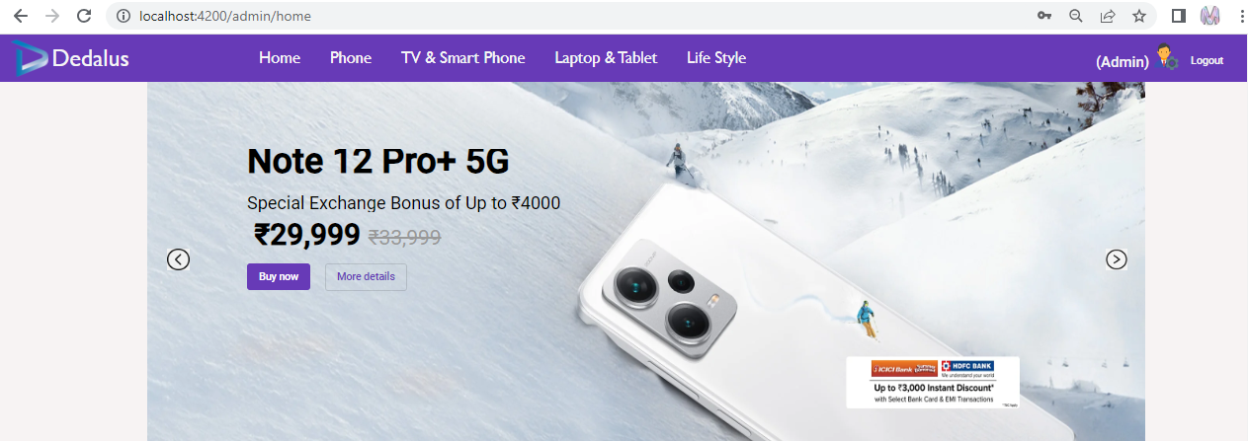
Admin Home Page

Slide 8
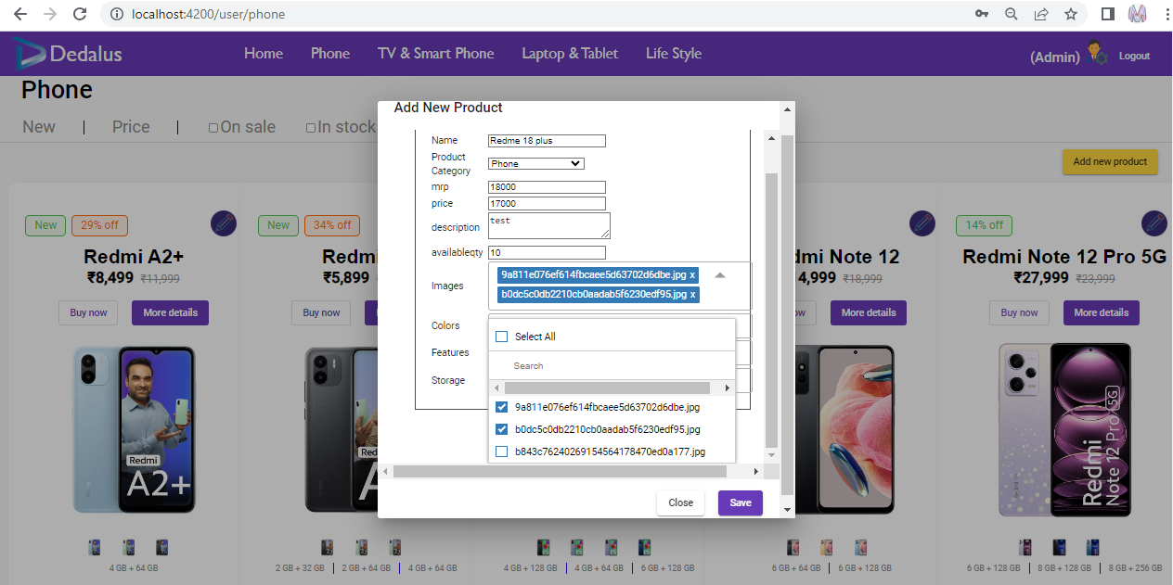
Admin New Product – Main Page

Slide 9
Thank you

